Slide 1
Function parameters

Slide 2
Function recap
Void function with no parameters
Function with no parameters, has return value
Function with arguments, no return value (void)
Both arguments and return value

Slide 3
Function prototype
Function Declaration
The C++ compiler requires specific information related to all functions in the program. To provide this information to the compiler, we can/must use a function declaration statement (or, function prototype declaration).
The syntax for declaring the function prototype is:

Slide 4
definition
A function definition is composed of two parts:
Function header
Function body
Forward declaration.

Slide 5
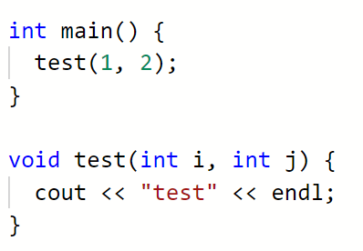
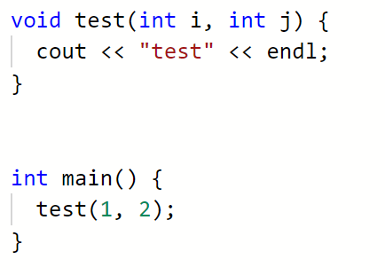
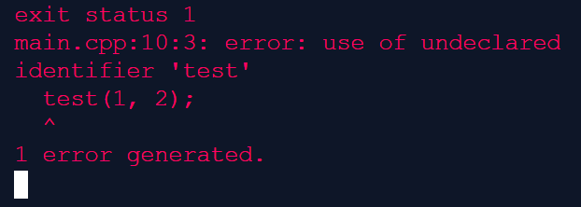
Fine:

Slide 6
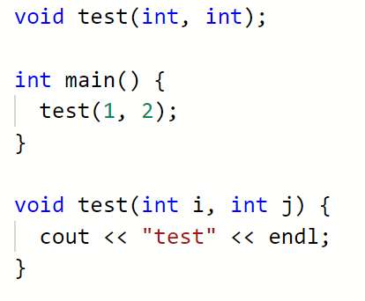
Fine:
Function prototype / declaration

Slide 7
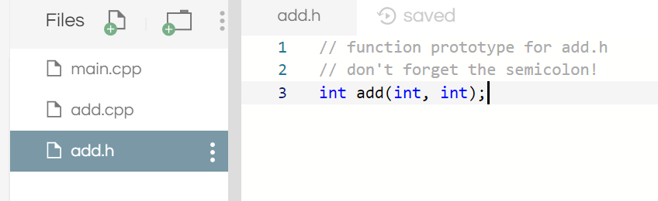
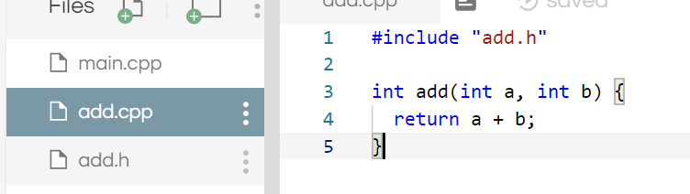
Header files

Slide 8
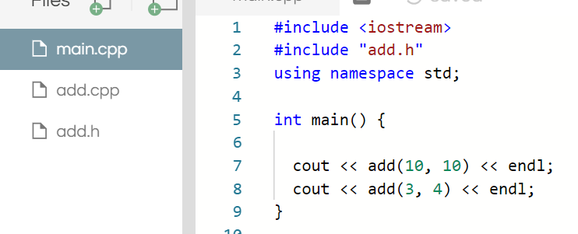


Slide 9

Angle bracket vs double quotes
Angles tell the compiler that this is a system library, it lives in the system directory
The quotes tell the compiler that this is a user library and lives either in this directory or in the user path
IDE – use the include path or search path

Slide 10
Why header files?
Improve build times
Link against code that you don’t have the source for (may not have been written yet)
Separate structure from implementation
Separate roles – one persons writes the headers, a team(s) writes the implementation
Tiny memory – during compilation no need to keep the module in memory
Most people dislike / hate header files. C++0x there was a proposal to remove them

Slide 11
Default parameters
Default values for functions
Arguments passed – use them
No argument passed – use the default value

Slide 12
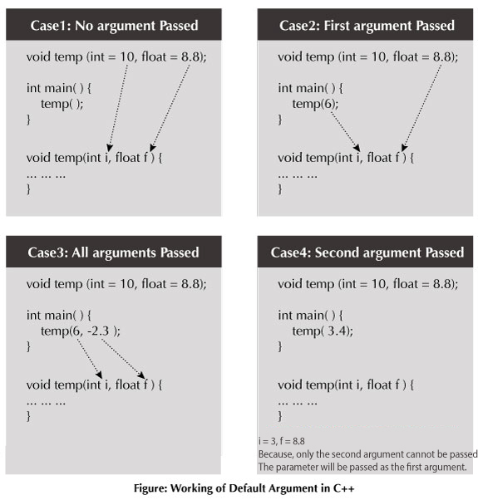

Slide 14
Common mistakes
Missing default in the middle

Slide 15
Passing parameters
Function parameters can be:
Pass by value
Pass by reference

Slide 16
Pass by value
The data for the parameter is copied to a new storage location
Then assigned to the parameter
Altering the parameter variable inside the function does not change the original

Slide 17
Pass by reference
Parameter variable is a pointer
This pointer points to the memory location that has the value in it
Changing this value also changes the variable in the calling function

Slide 18
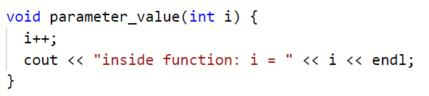
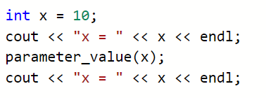


Slide 19
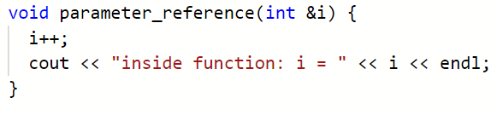
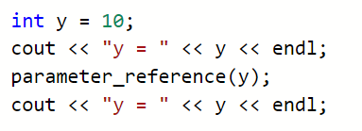


Slide 20
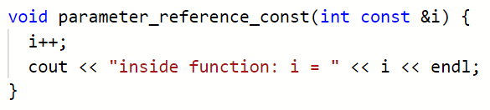
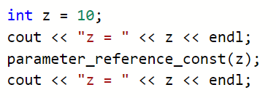
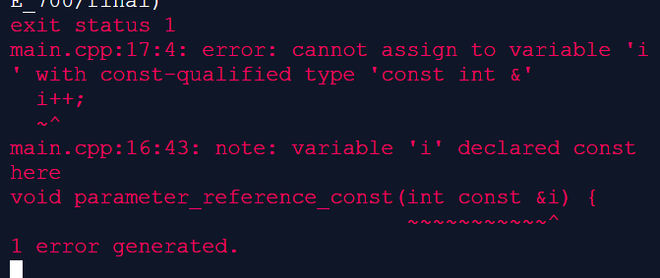

Slide 21
Pass by value
Advantages of passing by value:
Arguments passed by value can be variables, literals (e.g. 6), expressions (e.g. x+1), structs & classes, and enumerators. In other words, just about anything.
Arguments are never changed by the function being called. This prevents side effects.
Disadvantages of passing by value:
Copying structs and classes can incur a significant performance penalty, especially if the function is called many times.

Slide 22
Pass by value
When to use pass by value:
When passing fundamental data type and enumerators, and the function does not need to change the argument.
When not to use pass by value:
When passing arrays, structs or classes (including std::array, std::vector, and std::string).
In most cases, pass by value is the best way to accept parameters of fundamental types when the function does not need to change the argument. Pass by value is flexible and safe, and in the case of fundamental types, efficient.

Slide 23
Pass by reference
Pass-by-references is more efficient than pass-by-value, because it does not copy the arguments.
Modifications made to arguments passed in by reference in the called function have effect in the calling function
Use pass-by-reference if you want to modify the argument value in the calling function

Slide 24
Worksheet!

Slide 25
http://blmrgnn.blogspot.com/2014/01/pointers-references-and-dynamic-memory.html
Reference variables (in the above)
https://www.learncpp.com/cpp-tutorial/72-passing-arguments-by-value/

